Slide 1
Introduction to ASP .Net MVC
Course Code: CSC 4164
Course Title: ADVANCED PROGRAMMING WITH .NET
Dept. of Computer Science
Faculty of Science and Technology
Lecture No: | 03 | Week No: | 02 | Semester: | Fall 2020-2021
Lecturer: | Victor Stany Rozario, stany@aiub.edu

Slide 2
Lecture Outline
Traditional web application VS MVC application
MVC application lifecycle
Creating MVC application from scratch
Routing configuration
Controllers and Action Methods
Different Response Types
Views and different View engines

Slide 3
.NET
NET Framework – A technology introduced in 2002 which includes the ability to create executables, web applications, and services using C#,
Visual Basic, and F#.
ASP.NET – An open-source server-side web application framework which is a subset of Microsoft’s .NET framework. Their first iteration of ASP.NET included a technology called Web Forms.
ASP.NET WebForms – (2002 – current) A proprietary technique developed by Microsoft to manage state and form data across multiple pages.
ASP.NET MVC - Microsoft’s framework for developing fast web applications using their .NET platform with either the C# or VB.NET language.

Slide 4
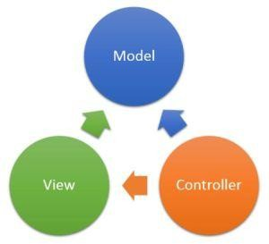
MVC application
What is MVC?
MVC is an architectural pattern that separates an application into three major parts called the Model, the View and the Controller.
•Models: Classes representing data of the application and that use validation logic to enforce business rules for that data.
•Views: Views are the components that display the application’s user interface (UI).
•Controllers: Classes that handle browser requests, retrieve model data, and specify view to return response to the browser.

Slide 5
MVC
Characteristics:
An alternative to ASP .NET Web Forms
Presentation framework
• Lightweight
• Highly testable
Integrated with the existing ASP .NET features:
• Master pages
• Membership-Based Authentication
Advantages:
• Easier to manage complexity (divide and conquer)
• It does not use server forms and view state
• Front Controller pattern (rich routing)
• Better support for test-driven development
• Ideal for distributed and large teams
• High degree of control over the application behavior
Features:
• Separation of application tasks
• Support for test-driven development
• Extensible and pluggable framework

Slide 6
Advantages of MVC
ASP.NET MVC has a separation of concerns: Separation of concerns means that your business logic is not contained in a View or controller. The business logic should be found in the models of your application. This makes web development even easier because it allows you to focus on integrating your business rules into reusable models.
ASP.NET MVC provides testability out of the box: Another selling point is that ASP.NET MVC allows you to test every single one of your components, thereby making your code almost bulletproof. The more unit tests you provide for your application, the more durable your application will become.
ASP.NET MVC has a smaller “View” footprint: With WebForms, there is a server variable called ViewState that tracks all of the controls on a page. If you have a ton of controls on your WebForm, the ViewState can grow to become an issue. ASP.NET MVC doesn’t have a ViewState, thus making the
View lean and mean.
ASP.NET MVC has more control over HTML: Since server-side controls aren’t used, the View can be as small as you want it to be. It provides a better granularity and control over how you want your pages rendered in the browser.

Slide 7
Differences between Traditional Web Application and MVC Application
MVC applications are testable, maintainable and easier to update rather than traditional ones.
Complexities are easily manageable in MVC applications due to separation of concerns.
Enables full control over the rendered HTML.
Better accessibility for implementing compliance with Web standards.
Facilitates adding more interactivity and responsiveness.

Slide 8
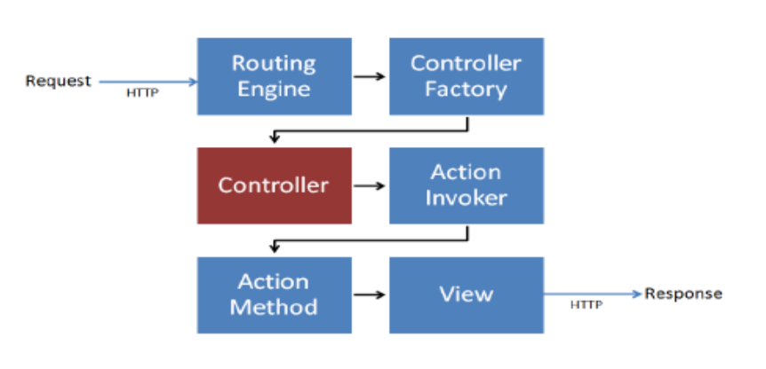
MVC application lifecycle

Slide 9
The entry point for every MVC application begins with routing. After the ASP.NET platform has received a request, it figures out how it should be handled through the URL Routing Module. Modules are .NET components that can hook into the application life cycle and add functionality. The routing module is responsible for matching the incoming URL to routes that we define in our application.
All routes have an associated route handler with them, and this is the entry point to the MVC framework.

Slide 10
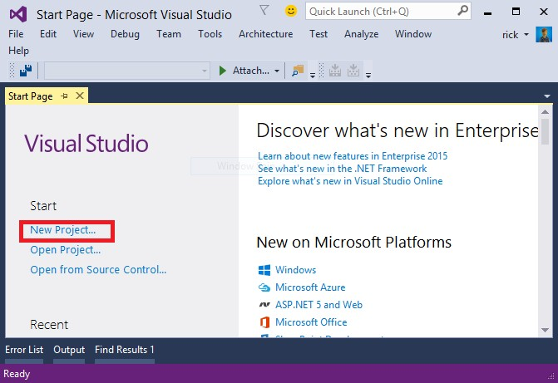
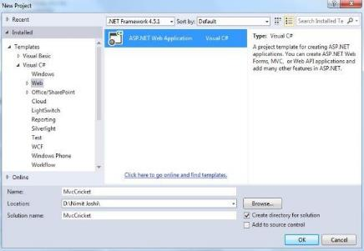

Creating MVC application
Step 1: Open Visual Studio
Step 2: Click on New Project to create a web application
7

Slide 11
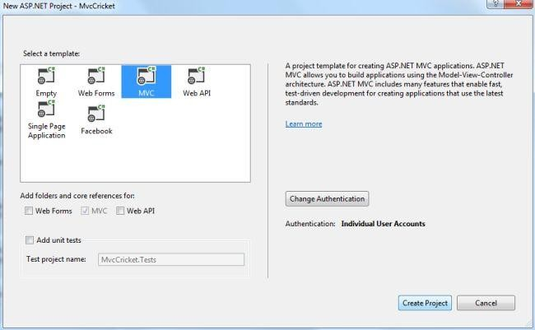
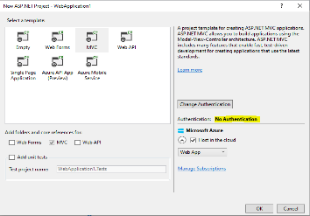
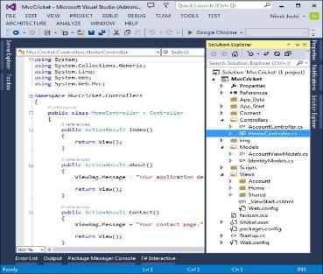

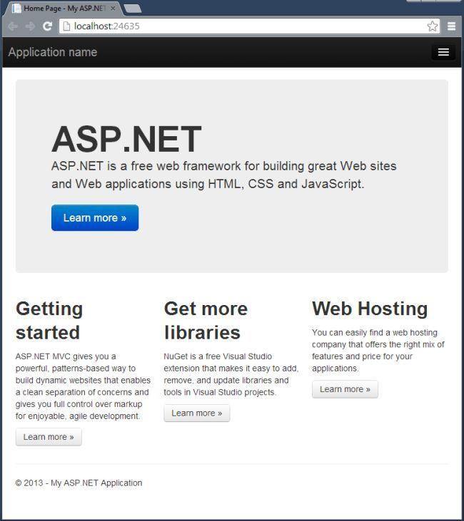
Step 3: Select the MVC Template
Step 4: Change authentication
You are ready to start after clicking onto OK

Slide 12
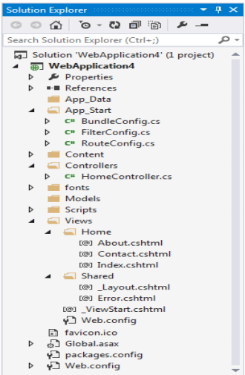
Layout of MVC structure
• App_Data – While I don’t use this folder often, it’s meant to hold data for your application (just as the name says). A couple of examples would include a portable database (like SQL Server Compact Edition) or any kind of data files (XML, JSON, etc.). I prefer
to use SQL Server.
• App_Start – The App_Start folder contains the initialization and configuration of different features of your application.
• BundleConfig.cs – This contains all of the configuration for minifying and compressing your JavaScript and CSS files into one file.
• FilterConfig.cs – Registers Global Filters.
• RouteConfig.cs – Configuration of your routes.
There are other xxxxConfig.cs files that are added when you apply other MVCrelated technologies (for example, WebAPI adds WebApiConfig.cs).

Slide 13
Layout of MVC structure
• Controllers – The controllers folder is where we place the controllers.
• Models – This folder contains your business models. It’s better when you have these models in another project, but for demo purposes, we’ll place them in here.
• Scripts – This is where your JavaScript scripts reside.
• Views – This parent folder contains all of your HTML “Views” with each controller name as a folder. Each folder will contain a number of cshtml files relating to the methods in that folder’s controller.
• Views/Shared – The Shared folder is meant for any shared cshtml files you need across the website.
• Global.asax – The Global.asax is meant for the initialization of the web application. If you look inside the Global.asax, you’ll notice that this is where the RouteConfig.cs, BundleConfig.cs, and FilterConfig.cs are called when the application runs.
• Web.Config – The web.config is where you place configuration settings for your application. For new MVC developers, it’s good to know that you can place settings inside the <appsettings> tag and place connection strings inside the <connectionstring> tag.

Slide 14
Routing Configuration
Routing is the process of directing an HTTP request to a controller and the functionality of this processing is implemented in System.Web.Routing. The Global.asax file is where you will define the route for your application.
namespace MVCFirstApp
{
public class MvcApplication : System.Web.HttpApplication
{
protected void Application_Start()
{
AreaRegistration.RegisterAllAreas();
RouteConfig.RegisterRoutes(RouteTable.Routes);
}
}
}

Slide 15
Following is the implementation of RouteConfig class, which contains one method RegisterRoutes. Define routes to map URLs to a specific controller action. ASP.NET MVC application uses routing rules defined in Global.asax to find out the appropriate Controller and pass the request.
namespace MVCFirstApp
{
public class RouteConfig
{
public static void RegisterRoutes(RouteCollection routes)
{
routes.IgnoreRoute("{resource}.axd/{*pathInfo}");
routes.MapRoute(
name: "Default",
url: "{controller}/{action}/{id}",
defaults: new { controller = "Home", action = "Index", id = UrlParameter.Optional }
);
}
}
}

Slide 16
Controllers and Action Methods
Controllers
In ASP.NET MVC, a Controller defines and groups a set of actions. The activities performed by the controller are given below:
Receives request sent by the client.
Calls necessary Model that will interact with database and fetch data back to Controller.
Controller further calls required View and pass the data which is further rendered to client as a response of the request.
Controller
Model
request
data
response
data
View
Database

Slide 17
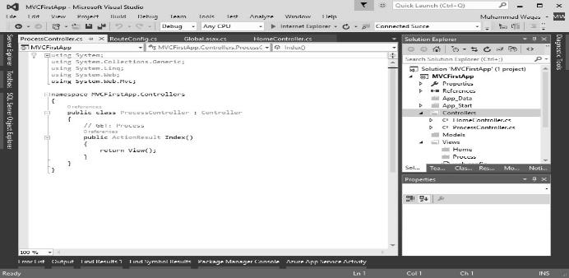
Action Methods
Action Methods are public methods inside a controller class.
A Controller class can have multiple action methods that are responsible for performing certain operations depending upon the client action.
Actions can return anything but often returns an instance of IActionResult that produces a response.
ProcessController has only one default Action Method called Index
Controller
Action method

Slide 18
Different response types
Action Result | Helper Method | Short Description
ViewResult | View | It renders a view as a web page
PartialViewResult | PartialView | It renders a PartialView.
RedirectToRouteResult | RedirectToAction or RedirectToRoute | It redirects to another action method.
JavaScriptResult | JavaScript | It returns a script that can be executed on client.
FileResult | File | It returns a binary output to for response.
ContentResult | Content | To return user-defined content type.

Slide 19
View & different view engines
Views
Responsible for providing the user interface to the user.
The view transforms a model into a format ready to be presented to the user.
The view examines the model object and transforms the contents to HTML
A parent folder contains all HTML “Views” with each controller name as a folder. Each folder will contain several cshtml files relating to the methods in that folder’s controller. Example: http://www.xyzcompany.com/Products/List we have a Products folder with a List.cshtml file. In the Controllers folder, open the ProductsController.cs and look for the List method.
Views/Shared – Meant for any shared cshtml files needed across the website.

Slide 20
View Engines
Views created using Razor view engine.
This engine works between view and browser to provide HTML to browser.
What is Razor?
– Introduced in ASP.NET MVC 3 and is the default view engine moving forward
– Provides a clean, lightweight, simple view engine.
– Provides a streamlined syntax for expressing views
– Minimizes the amount of syntax and extra characters.
Razor View Engine has .cshtml (with C#) and .vbhtml (with VB) extension for views.

Slide 21
Different view engines
There are many types of view engines and these are:
ASPX
Razor
Spark
NHaml
NDJango
Hasic
Brail

Slide 22
Books
Beginning ASP.NET 4: in C# and VB; Imar Spaanjaars,2010
Beginning ASP.NET 3.5 in C# 2008: From Novice to Professional; 2nd edition, Matthew MacDonald,2007
ASP.NET 3.5 Unleashed by Stephen Walther, 2008
Pro ASP.NET 3.5 in C# 2008: Includes Silverlight 2 by Matthew MacDonald,2008
ASP.NET 3.5 For Dummies by Ken Cox,2008

Slide 23
References
ASP.NET; URL: https://dotnet.microsoft.com/apps/aspnet
URL: https://www. tutorialspoint.com/index.htm
URL: http://www.webdevelopmenthelp.net/2014
View Engines; URL: https://www.tutorialride.com/asp-net-mvc

Slide 24
Thank you!

